Slide 1
The Progress of The US Economy Before the Pandemic
Reuben Rinu

Slide 2
What is the US Economy, and Why Should We Study It?
The US Economy refers to the comprehensive economic system of the United States, encompassing the production, distribution, and consumption of goods and services within the country, as well as the intricate network of markets, industries, and financial institutions that drive economic activity.
Studying the US Economy is of paramount importance due to its substantial global influence, as the performance of the US Economy significantly affects other economies, international trade, and financial markets, making it essential to comprehend its dynamics and trends for effective decision-making, strategic planning, and identifying potential business opportunities.

Slide 3

Data Links:
Unemployment Rate in America : https://catalog.data.gov/dataset/employment-unemployment-and-labor-force-data
GDP Growth in America:
https://fred.stlouisfed.org/series/GDP
Inflation % in America:
https://fred.stlouisfed.org/series/FPCPITOTLZGUSA

Slide 4
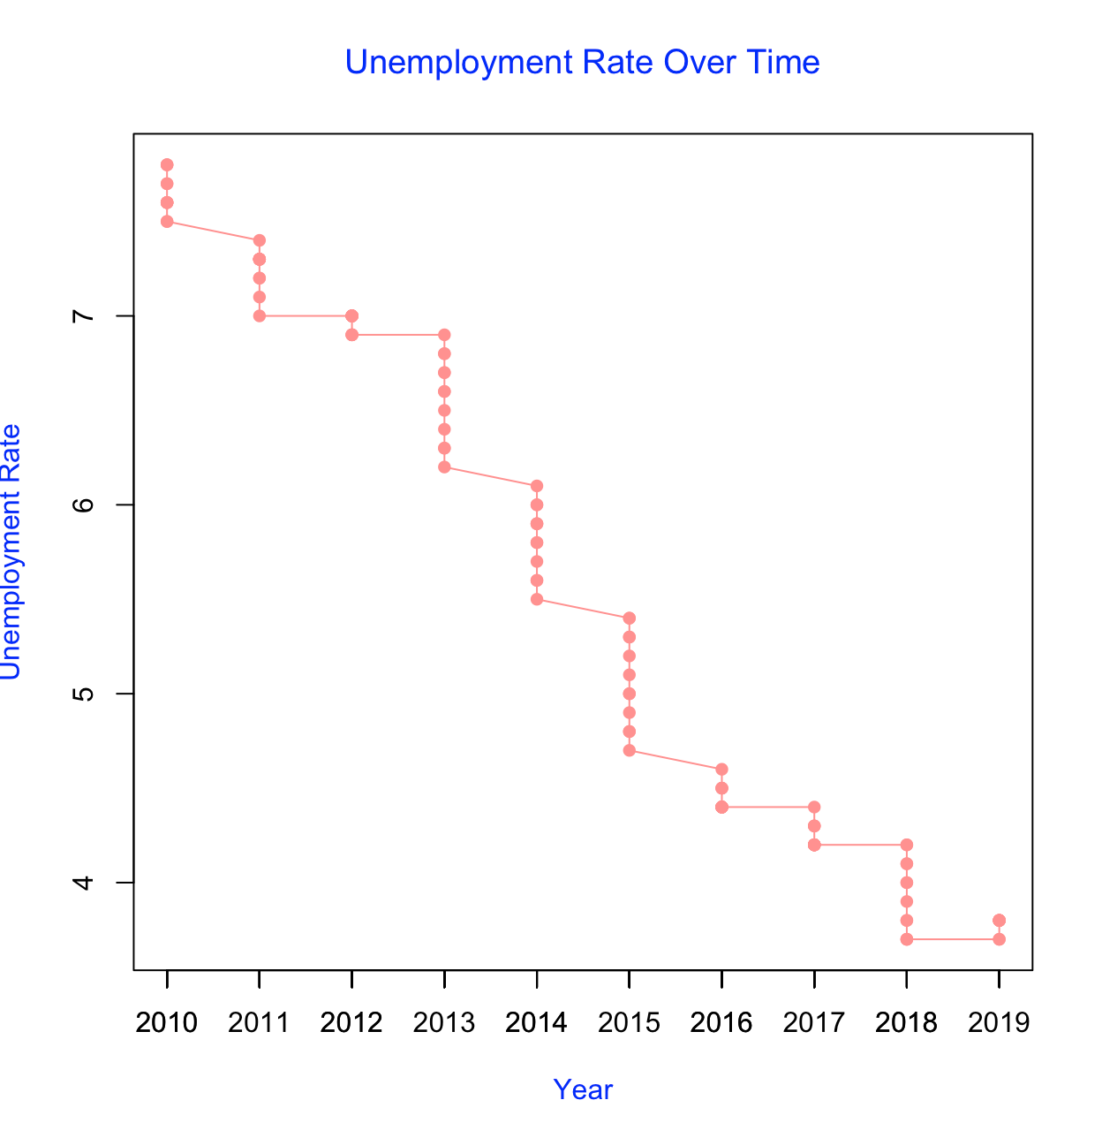
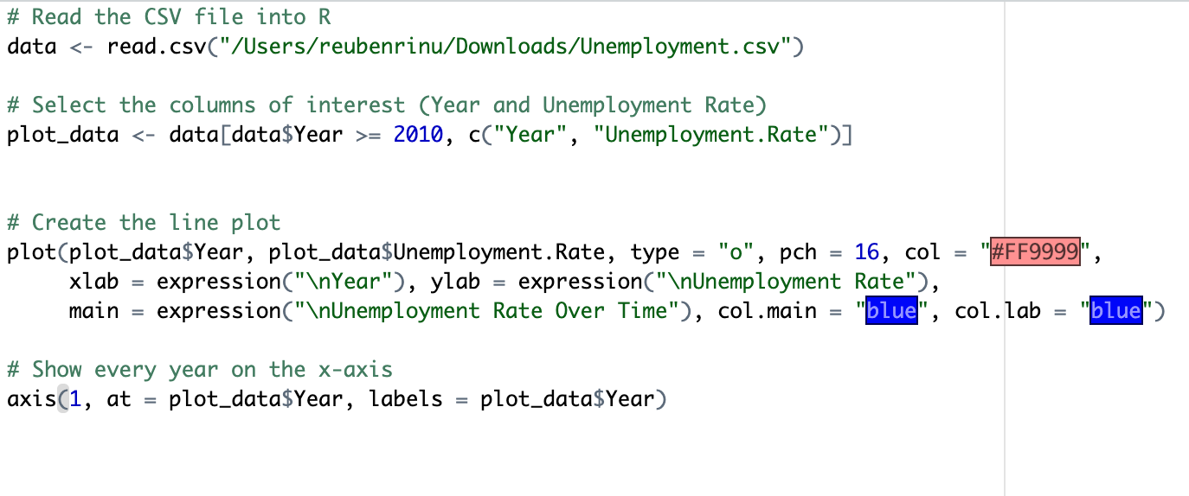
Unemployment
This Graph here shows that from 2010-2019, the US Unemployment Rate was getting lower each year, which shows that more people were joining the workforce, meaning more money was spent in the economy, showing economic growth.

Slide 5
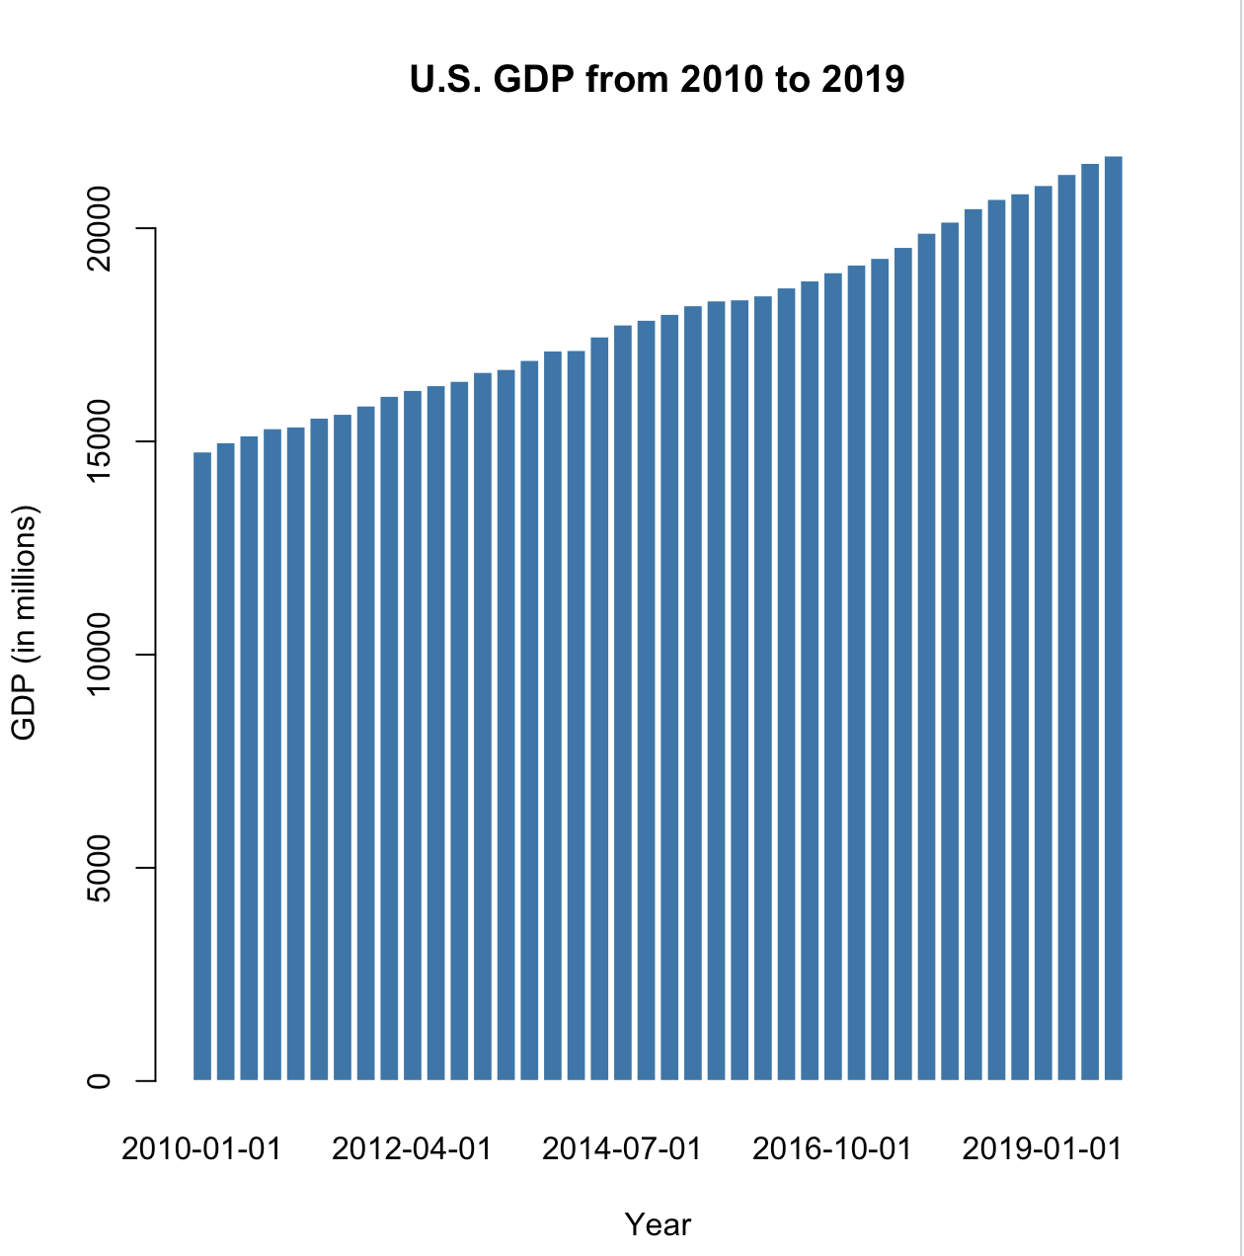
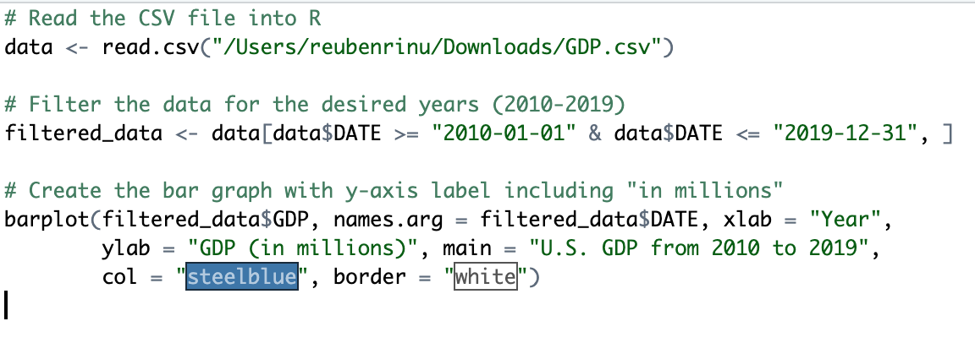
U.S. GDP
This Graph here shows that from 2010-2019, the US GDP was rising steadily, a steady rise in Gross Domestic Product (GDP) is often considered an indicator of economic growth as GDP is a measure of the total value of goods and services produced within a country's borders over a specific period.

Slide 6
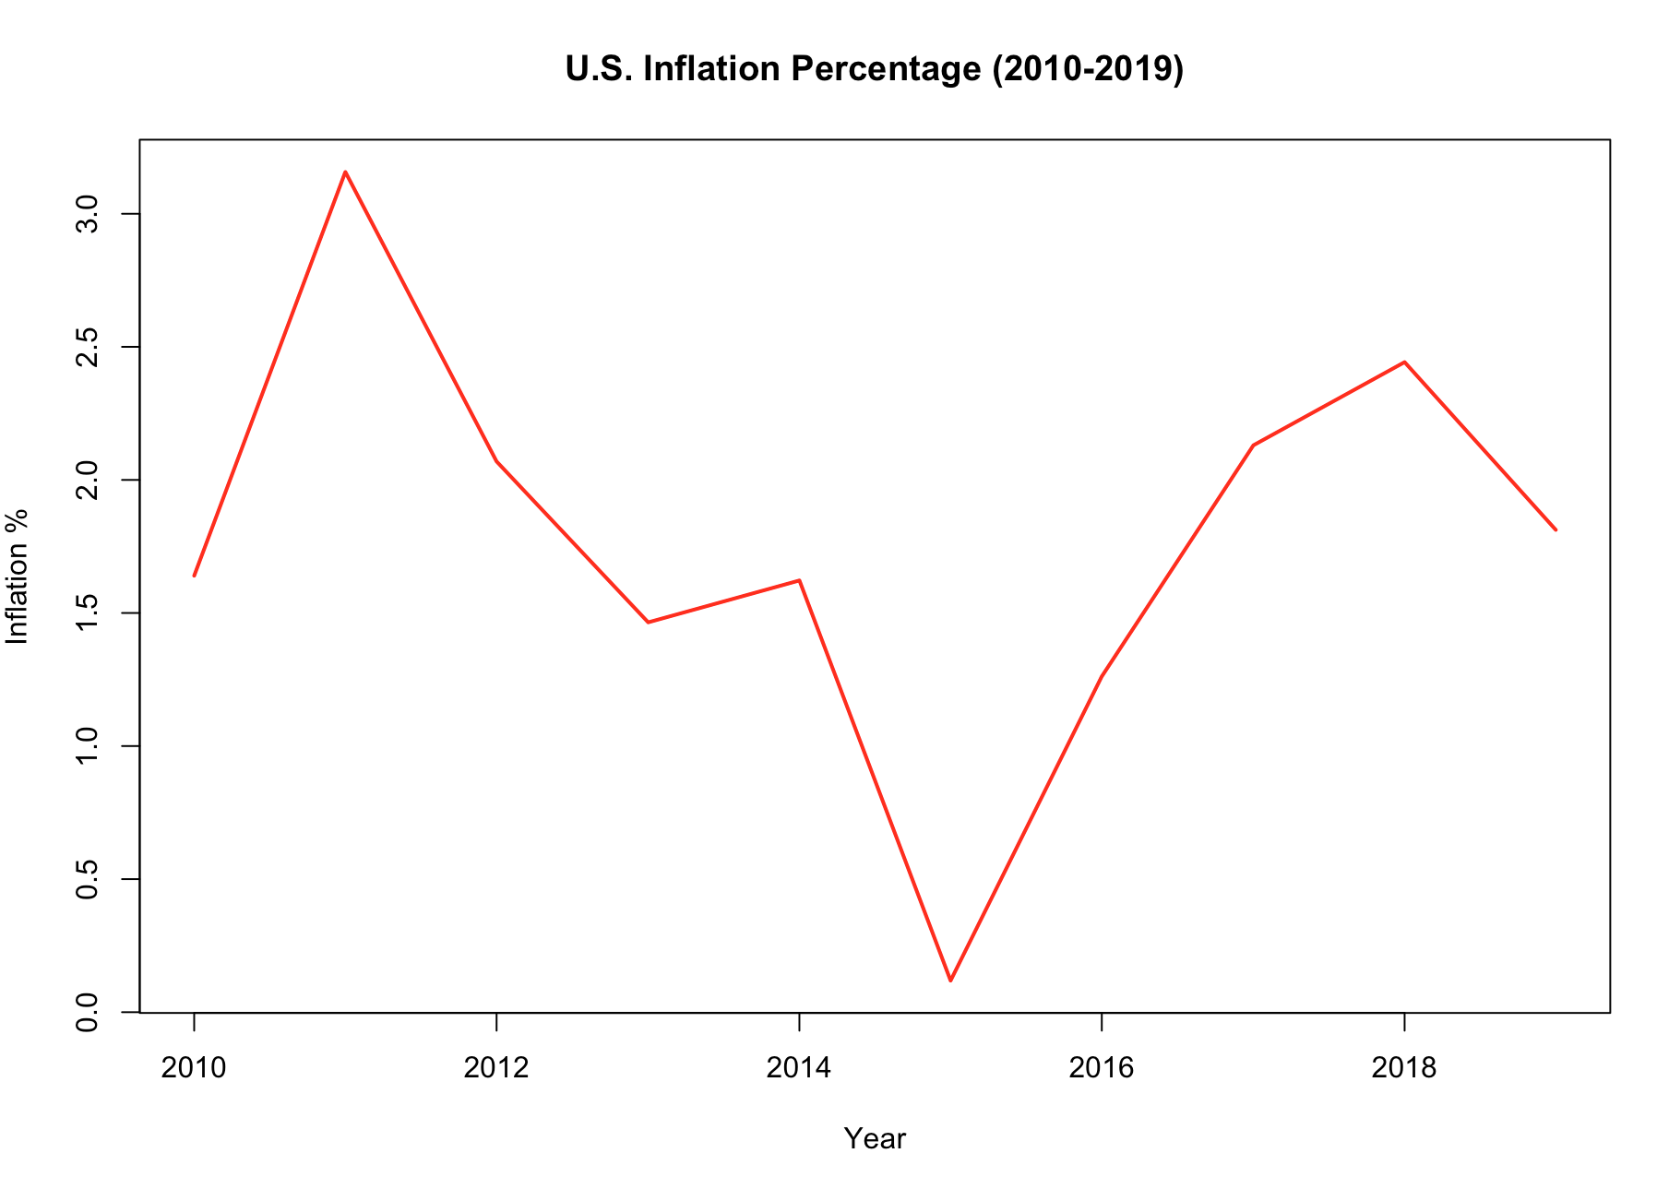
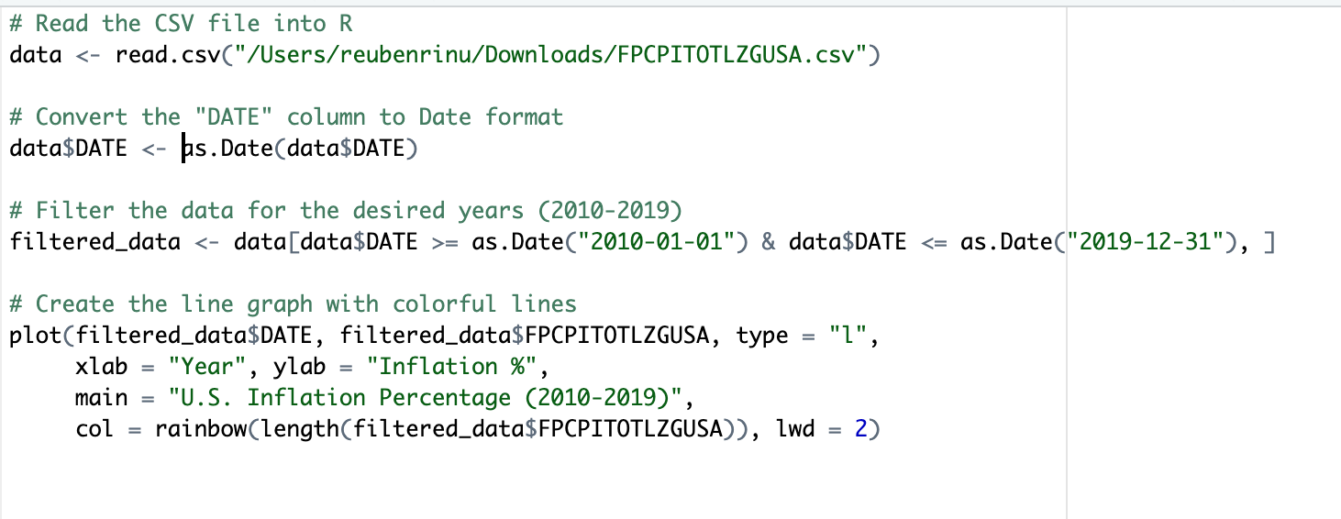
Unemployment
Finally, the last metric is the Inflation %, which shows an overall decrease, aside from the spike in 2015 that carried into 2019.

Slide 7
Conclusion
Overall, it can be learned from the graphs that the US Economy was growing steadily from the years 2010-2019, which goes to show an age of economic prosperity that was over the US. This also goes to show the effects of the pandemic, which struck at a time of Record Low Unemployment and Record High GDP.

